Slide 1
INFO 250 Information Visualization
6B ggplot continued … layers and more examples
Volcanos and Earthquakes
Load data from xlsx and other formats
Map overlays and more

Slide 2
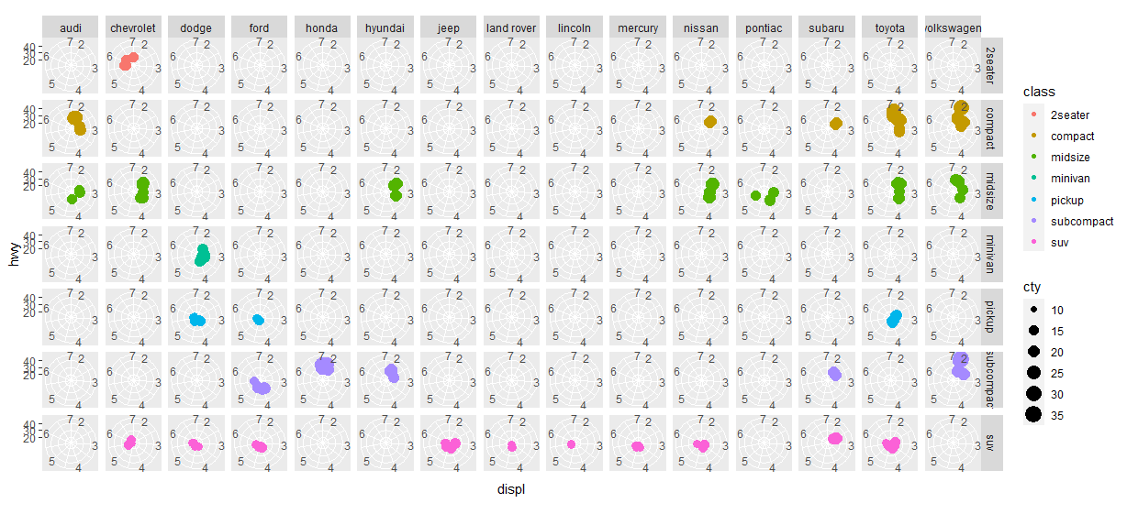
mychart + facet_grid(class~manufacturer) + coord_polar()

Slide 3
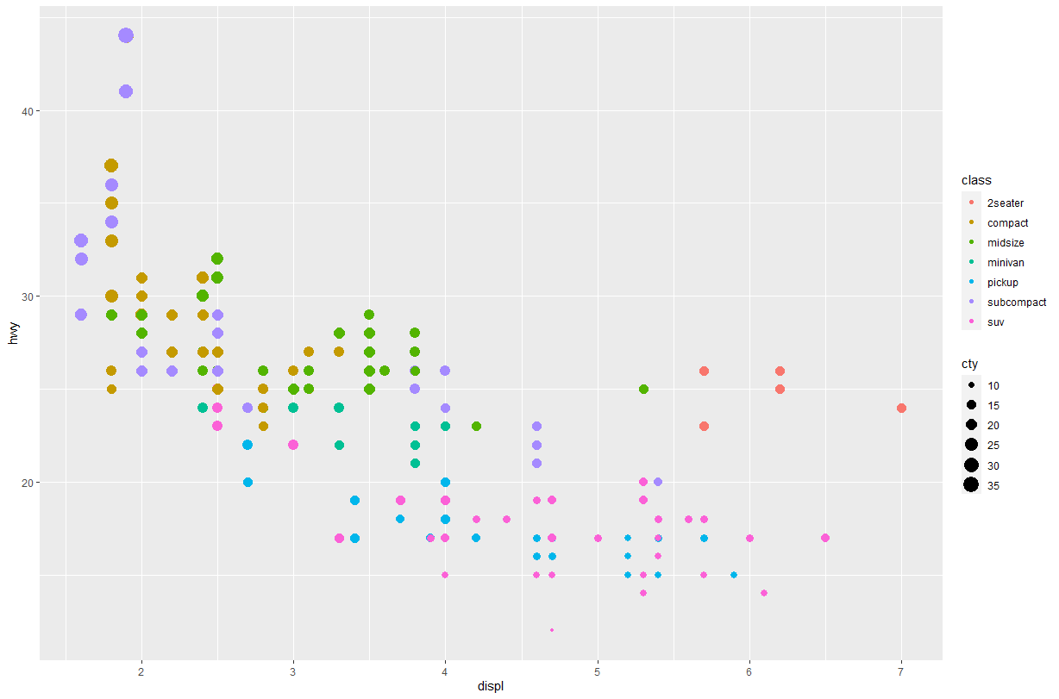
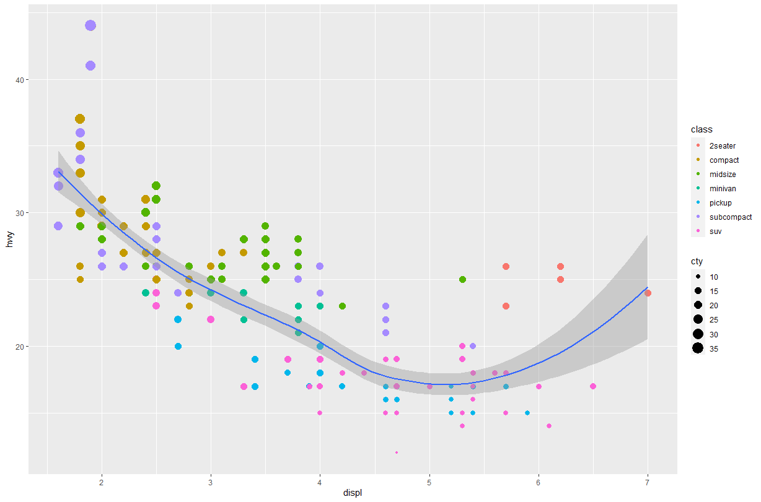
mychart + geom_smooth()

Slide 4
Data Input
Reads a file in table format and creates a data frame from it, with cases corresponding to lines and variables to fields in the file.
Usage
read.table(file, header = FALSE, sep = "", quote = "\"'",
dec = ".", numerals = c("allow.loss", "warn.loss", "no.loss"),
row.names, col.names, as.is = !stringsAsFactors,
na.strings = "NA", colClasses = NA, nrows = -1,
skip = 0, check.names = TRUE, fill = !blank.lines.skip,
strip.white = FALSE, blank.lines.skip = TRUE,
comment.char = "#",
allowEscapes = FALSE, flush = FALSE,
stringsAsFactors = FALSE,
fileEncoding = "", encoding = "unknown", text, skipNul = FALSE)
read.csv(file, header = TRUE, sep = ",", quote = "\"",
dec = ".", fill = TRUE, comment.char = "", ...)
read.delim(file, header = TRUE, sep = "\t", quote = "\"",
dec = ".", fill = TRUE, comment.char = "", ...)

Slide 5
Exercise
read.csv(file, header = TRUE, sep = ",", quote = "\"",
dec = ".", fill = TRUE, comment.char = "", ...)
read.delim(file, header = TRUE, sep = "\t", quote = "\"",
dec = ".", fill = TRUE, comment.char = "", ...)

Slide 6
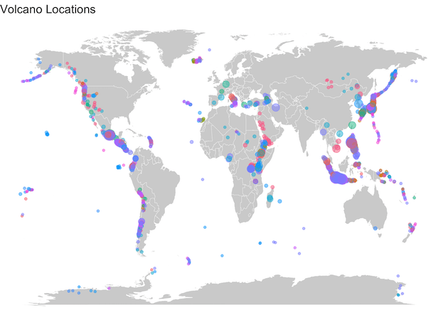
Volcanos
https://datavizpyr.com/how-to-make-world-map-with-ggplot2-in-r/

Slide 7
Volcanos (CSV) Load Data in CSV from a Web Server
> library("tidyverse")
> volcano <- readr::read_csv("https://raw.githubusercontent.com/rfordatascience/tidytuesday/master/data/2020/2020-05-12/volcano.csv")

Slide 8
> volcano
# A tibble: 958 × 26
volcano…¹ volca…² prima…³ last_…⁴ country region subre…⁵ latit…⁶
<dbl> <chr> <chr> <chr> <chr> <chr> <chr> <dbl>
1 283001 Abu Shield… -6850 Japan Japan… Honshu 34.5
2 355096 Acamar… Strato… Unknown Chile South… Northe… -23.3
3 342080 Acaten… Strato… 1972 Guatem… Méxic… Guatem… 14.5
4 213004 Acigol… Caldera -2080 Turkey Medit… Turkey 38.5
5 321040 Adams Strato… 950 United… Canad… USA (W… 46.2
6 283170 Adatar… Strato… 1996 Japan Japan… Honshu 37.6
7 221170 Adwa Strato… Unknown Ethiop… Afric… Africa… 10.1
8 221110 Afdera Strato… Unknown Ethiop… Afric… Africa… 13.1
9 284160 Agrigan Strato… 1917 United… Japan… Izu, V… 18.8
10 342100 Agua Strato… Unknown Guatem… Méxic… Guatem… 14.5
# … with 948 more rows, 18 more variables: longitude <dbl>,
# elevation <dbl>, tectonic_settings <chr>,
# evidence_category <chr>, major_rock_1 <chr>,
# major_rock_2 <chr>, major_rock_3 <chr>, major_rock_4 <chr>,
# major_rock_5 <chr>, minor_rock_1 <chr>, minor_rock_2 <chr>,
# minor_rock_3 <chr>, minor_rock_4 <chr>, minor_rock_5 <chr>,
# population_within_5_km <dbl>, population_within_10_km <dbl>, …
# ℹ Use `print(n = ...)` to see more rows, and `colnames()` to see all variable names

Slide 9
Learn more about the Volcano data
> colnames(volcano)
[1] "volcano_number" "volcano_name" "primary_volcano_type"
[4] "last_eruption_year" "country" "region"
[7] "subregion" "latitude" "longitude"
[10] "elevation" "tectonic_settings" "evidence_category"
[13] "major_rock_1" "major_rock_2" "major_rock_3"
[16] "major_rock_4" "major_rock_5" "minor_rock_1"
[19] "minor_rock_2" "minor_rock_3" "minor_rock_4"
[22] "minor_rock_5" "population_within_5_km" "population_within_10_km"
[25] "population_within_30_km" "population_within_100_km"

Slide 10
Select a Subset of the Volcano Data
volcano %>%
select(primary_volcano_type, longitude,
latitude, population_within_100_km) %>%
head()
## # A tibble: 6 x 4
## primary_volcano_type longitude latitude population_within_100_km
## <chr> <dbl> <dbl> <dbl>
## 1 Shield(s) 132. 34.5 4071152
## 2 Stratovolcano -67.6 -23.3 9092
## 3 Stratovolcano(es) -90.9 14.5 7634778
## 4 Caldera 34.6 38.5 2253483
## 5 Stratovolcano -121. 46.2 393303
## 6 Stratovolcano(es) 140. 37.6 5024654

Slide 11
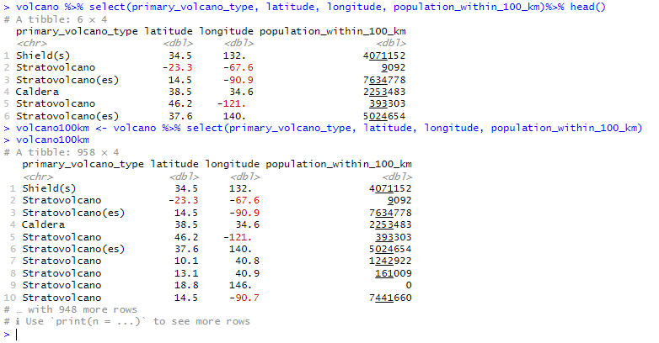
> volcano100km <- volcano %>% select(primary_volcano_type, latitude, longitude, population_within_100_km)

Slide 12
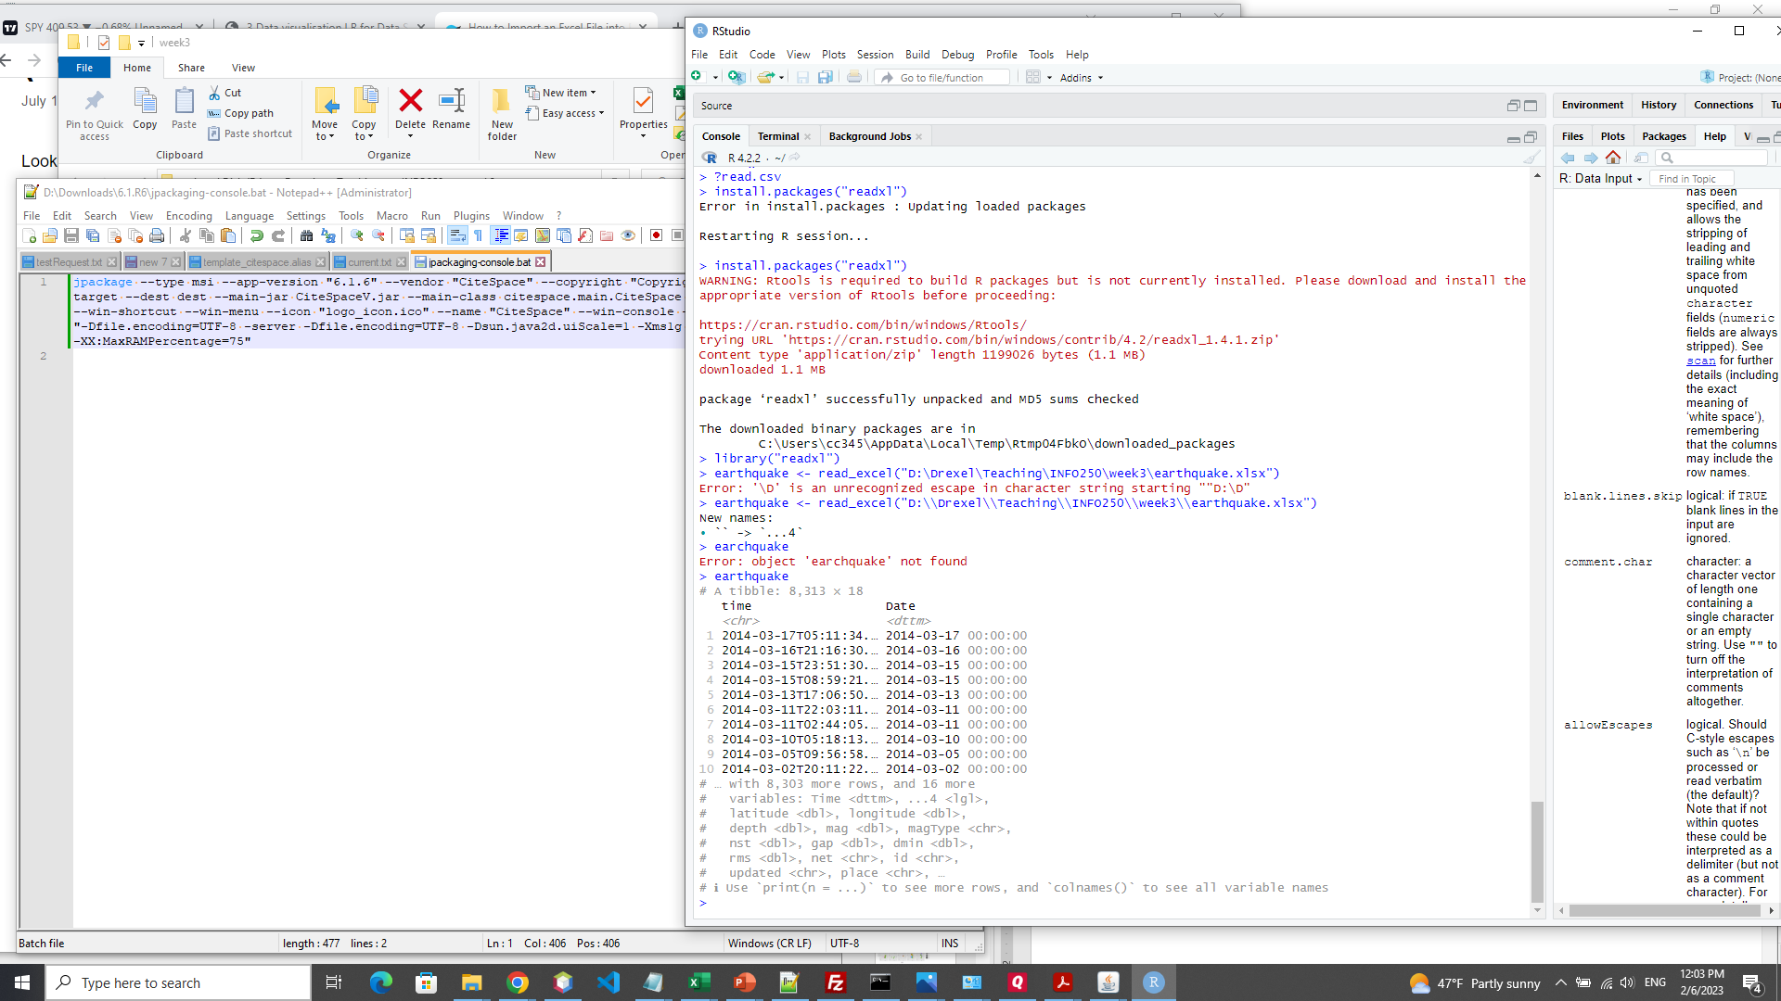
Earthquakes (xlsx)
D:\Drexel\Teaching\INFO250\week3\earthquake.xlsx

Slide 14
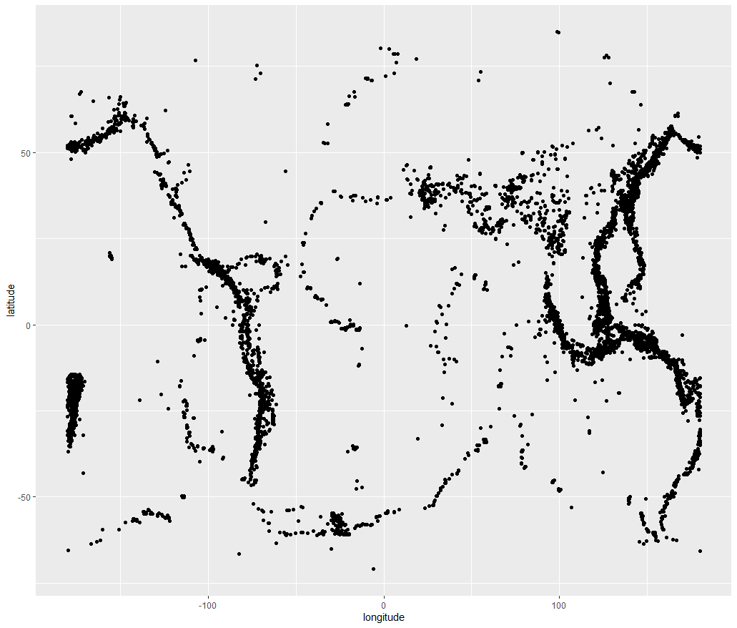
ggplot(earthquake, aes(longitude, latitude)) + geom_point()

Slide 15
Sequential, diverging and qualitative color scales from ColorBrewer
The brewer scales provide sequential, diverging and qualitative color schemes from ColorBrewer. These are particularly well suited to display discrete values on a map. See https://colorbrewer2.org for more information.
scale_color_brewer(
...,
type = "seq",
palette = 1,
direction = 1,
aesthetics = "colour"
)
scale_fill_brewer(
...,
type = "seq",
palette = 1,
direction = 1,
aesthetics = "fill"
)
scale_colour_distiller(
...,
type = "seq",
palette = 1,
direction = -1,
values = NULL,
space = "Lab",
na.value = "grey50",
guide = "colourbar",
aesthetics = "colour"
)

Slide 16
Gradient color scales
⁠scale_*_gradient⁠ creates a two color gradient (low-high), ⁠scale_*_gradient2⁠ creates a diverging color gradient (low-mid-high), ⁠scale_*_gradientn⁠ creates a n-color gradient.
# Avoid red-green colour contrasts because ~10% of men have difficulty seeing them
ggplot(df, aes(x, y)) +
geom_point(aes(colour = z2)) +
scale_color_gradient(low = "white", high = "black")
# Use `na.value = NA` to hide missing values but keep the original axis range
ggplot(df_na, aes(x = value, y)) +
geom_bar(aes(fill = z1), stat = "identity") +
scale_fill_gradient(low = "yellow", high = "red", na.value = NA)
ggplot(df_na, aes(x, y)) +
geom_point(aes(colour = z1)) +
scale_color_gradient(low = "yellow", high = "red", na.value = NA)

Slide 17
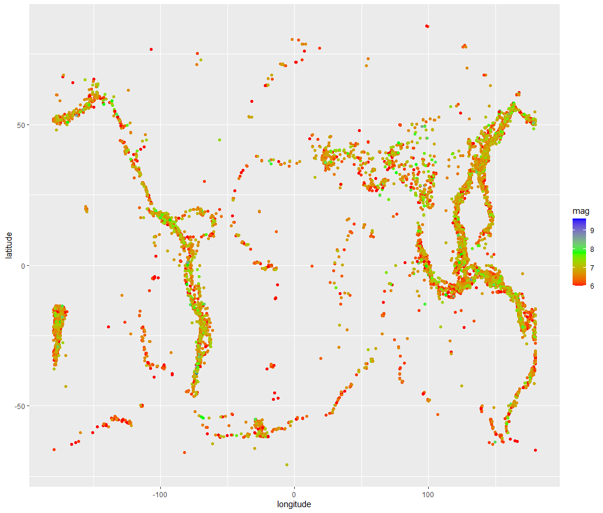
ggplot(earthquake, aes(longitude, latitude, color=mag)) + geom_point() + scale_color_gradientn(colours = rainbow(3))

Slide 18
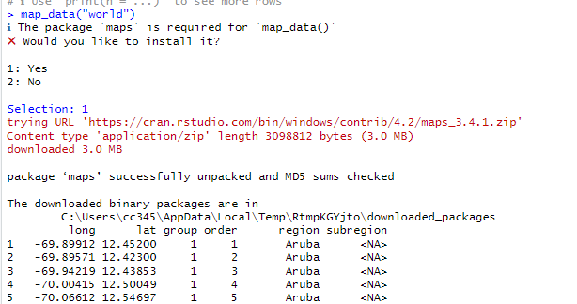
Package ‘maps’: map_data(“world”)
[ reached 'max' / getOption("max.print") -- omitted 99172 rows ]

Slide 19
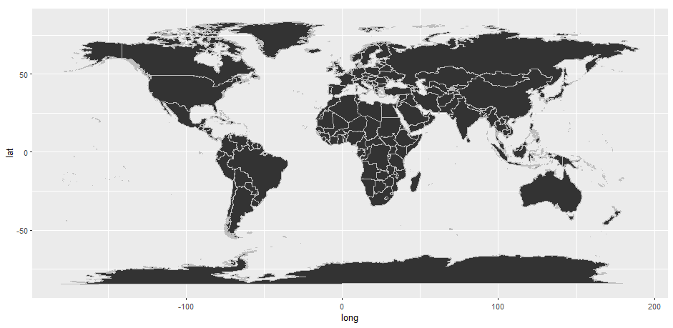
Base Map: the World Map
world <- map_data(“world”)
ggplot(world) + geom_map(map=world, aes(long, lat, map_id=region), color="gray") +
expand_limits(x=world$long, y=world$lat) + coord_fixed()

Slide 20
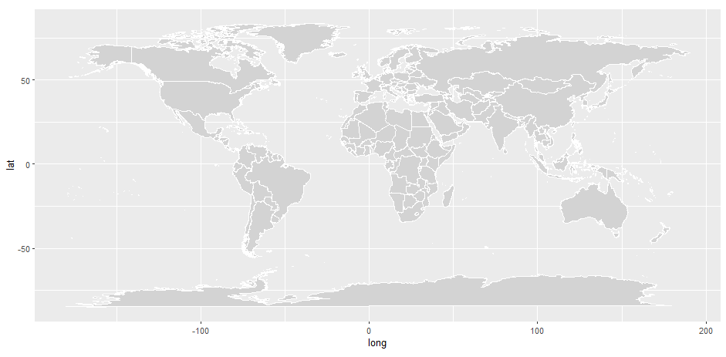
ggplot(world) +
geom_map(map=world, aes(long, lat, map_id=region), color=“white", fill="lightgray", size=0.1) +
expand_limits(x=world$long, y=world$lat) +
coord_fixed()

Slide 21
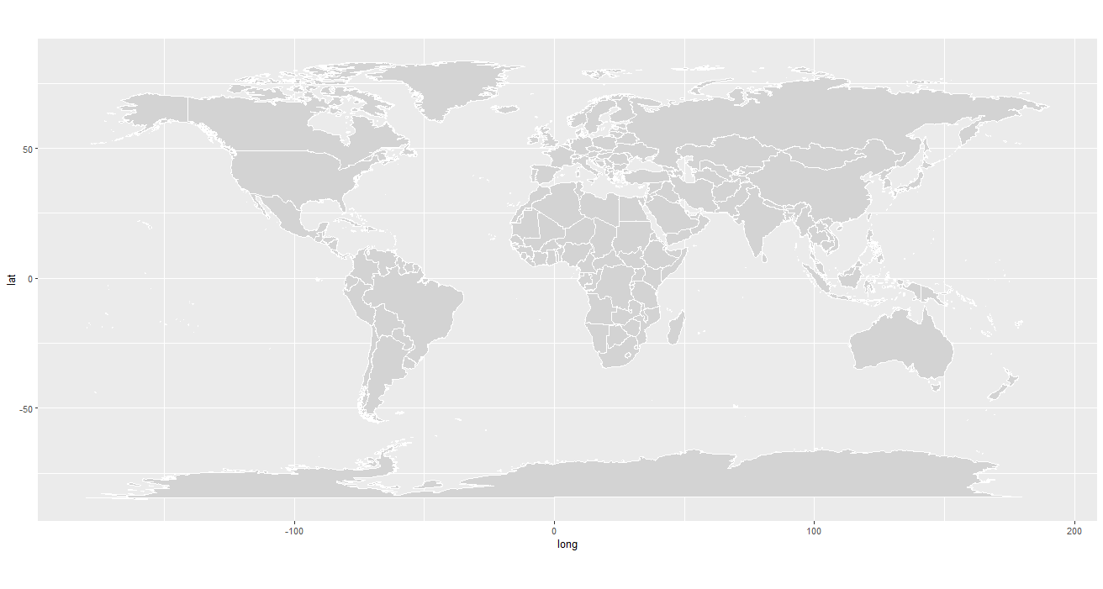
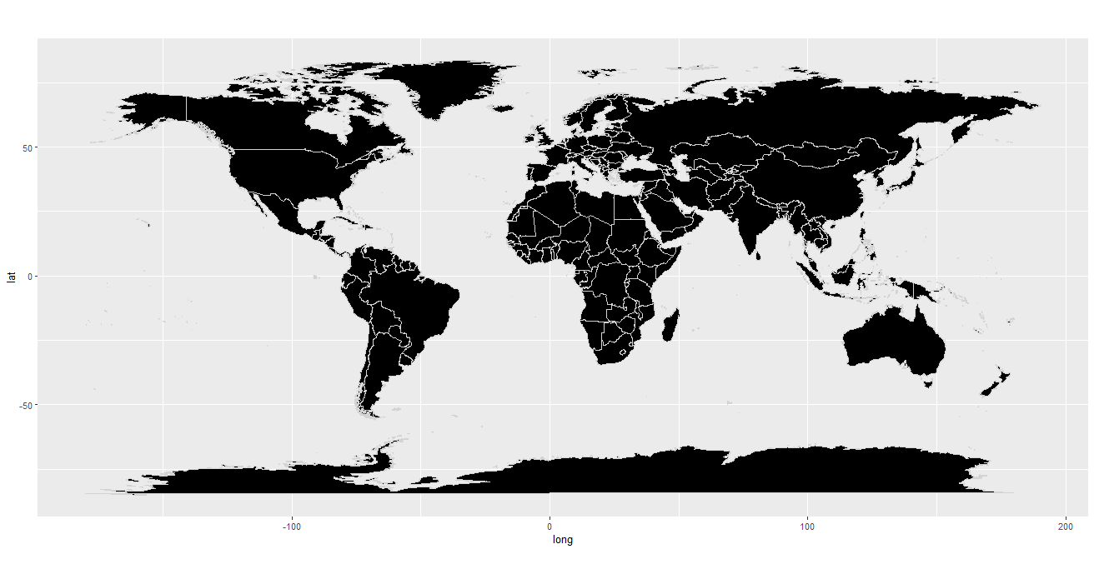
worldmap <- ggplot(world) +
geom_map(map=world, aes(long, lat, map_id=region), color="white", fill="lightgray", size=0.1) +
expand_limits(x=world$long, y=world$lat) +
coord_fixed()
worldmap2<-ggplot(world) +
geom_map(map=world, aes(long, lat, map_id=region), color="lightgrey", fill="black", size=0.1) +
expand_limits(x=world$long, y=world$lat) +
coord_fixed()

Slide 22
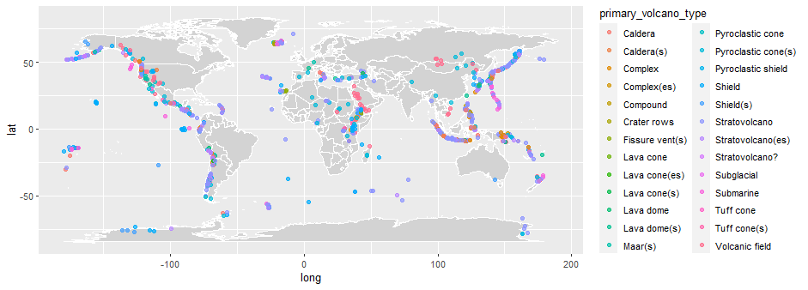
Where are the Vocanos?
worldmap <- ggplot(world) +
geom_map(map=world, aes(long, lat, map_id=region), color="white", fill="lightgray", size=0.1) +
expand_limits(x=world$long, y=world$lat) +
coord_fixed()
worldmap + geom_point(data = volcano, aes(longitude, latitude, color = primary_volcano_type), alpha = 0.7)

Slide 23
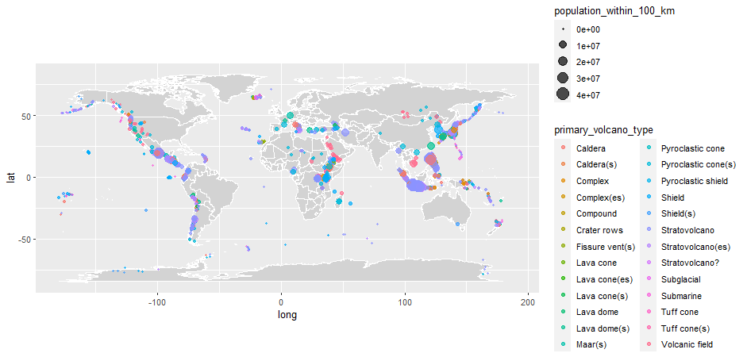
Size = population_within_100_km
worldmap +
geom_point( data = volcano100km,
aes(longitude, latitude, color = primary_volcano_type, size=population_within_100_km), alpha = 0.7)

Slide 24
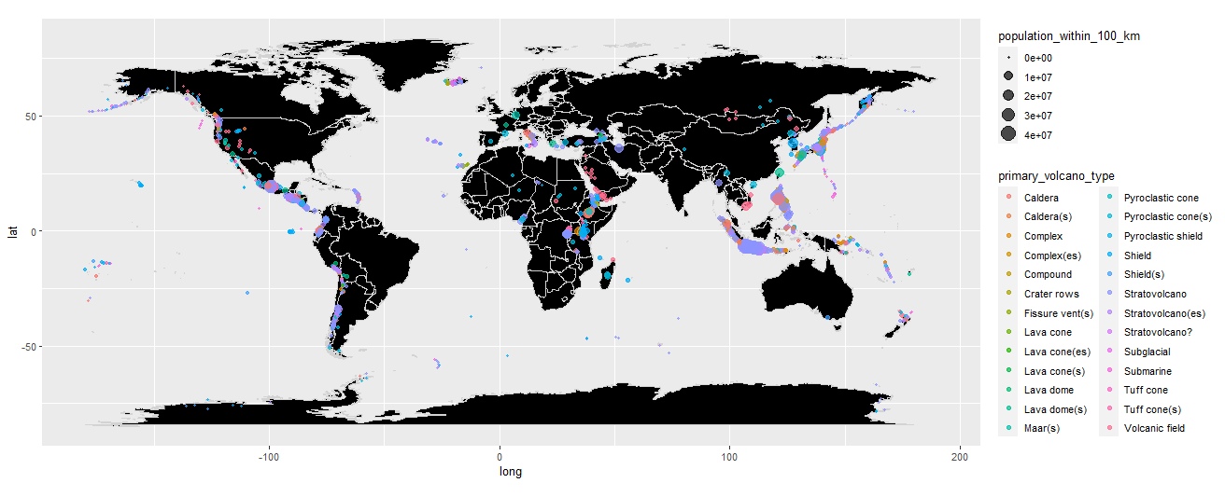
Size = population_within_100_km
worldmap2 +
geom_point( data = volcano100km,
aes(longitude, latitude, color = primary_volcano_type, size=population_within_100_km), alpha = 0.7)

Slide 25
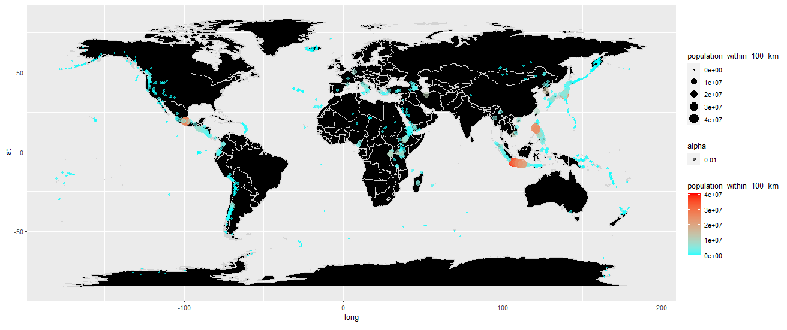
Size = population_within_100_km
worldmap2 + geom_point(data=volcano, aes(longitude, latitude, color=population_within_100_km,size=population_within_100_km,alpha=0.01)) + scale_color_gradient(low="cyan", high = "red")

Slide 26
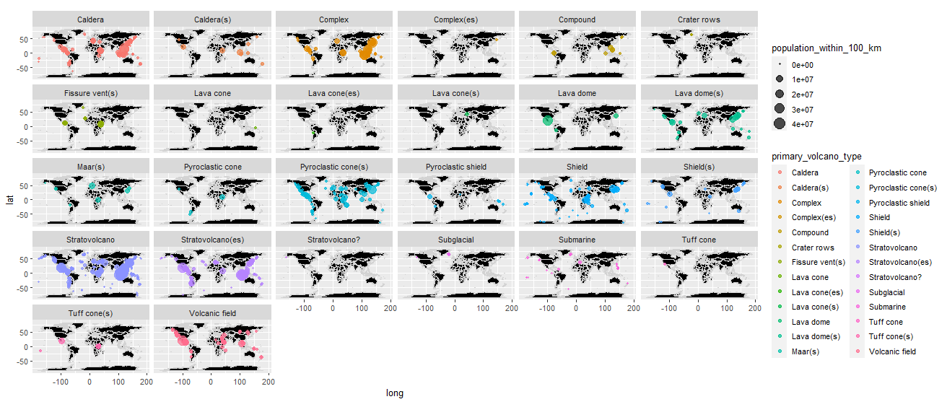
worldmap2 + geom_point( data = volcano100km, aes(longitude, latitude, color = primary_volcano_type, size=population_within_100_km), alpha = 0.7) + facet_wrap(~primary_volcano_type)

Slide 27
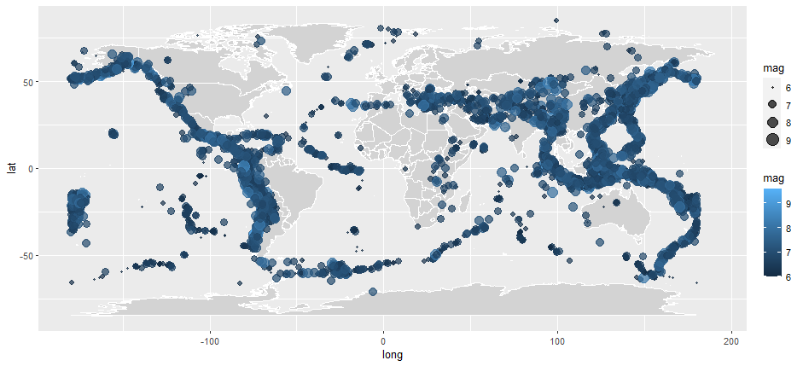
Earthquakes
worldmap +
geom_point( data = earthquake,
aes(longitude, latitude, color = mag, size=mag),
alpha = 0.7 )

Slide 28
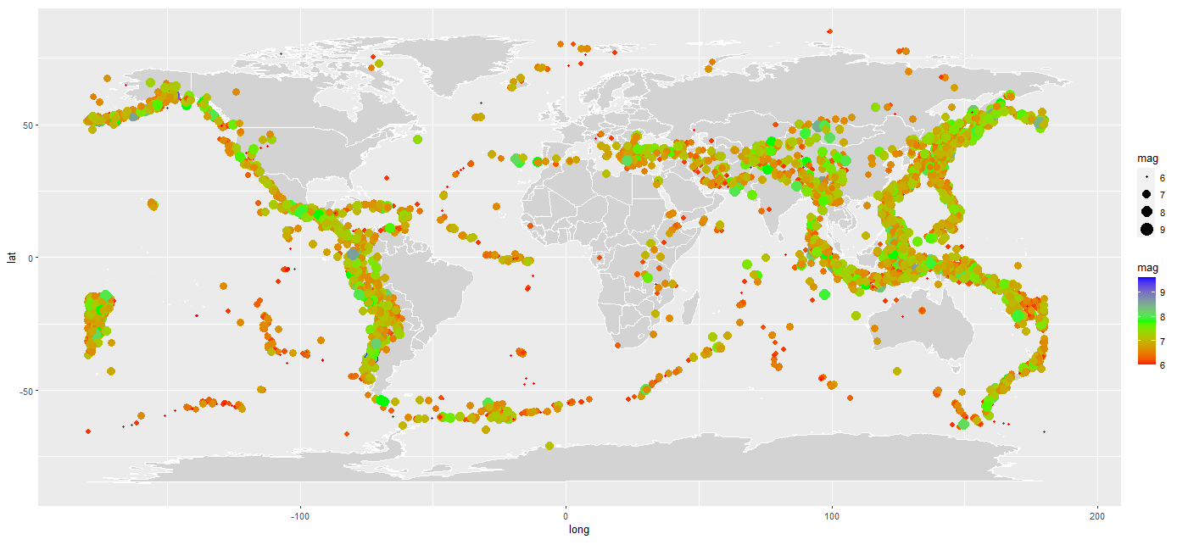
Earthquakes
worldmap + geom_point(data=earthquake, aes(longitude, latitude, color=mag, size=mag))+scale_color_gradientn(colors = rainbow(3))

Slide 29
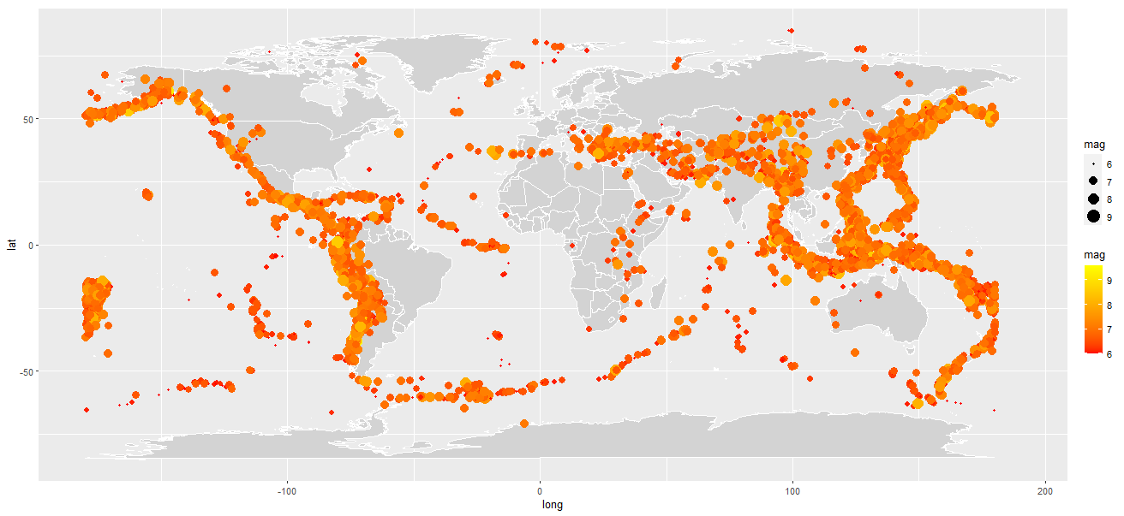
Earthquakes
worldmap + geom_point(data=earthquake, aes(longitude, latitude, color=mag, size=mag)) + scale_color_gradient(high = "#ffff00", low = "#ff0000")

Slide 30
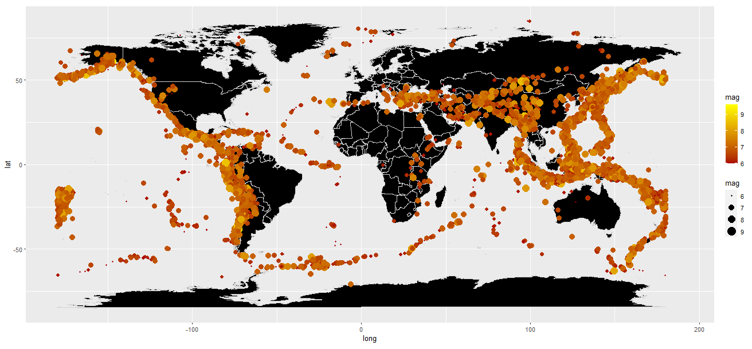
Earthquakes
worldmap2 + geom_point(data=earthquake, aes(longitude, latitude, color=mag, size=mag)) + scale_color_gradient(high = "#ffff00", low = "#aa0000")

Slide 31
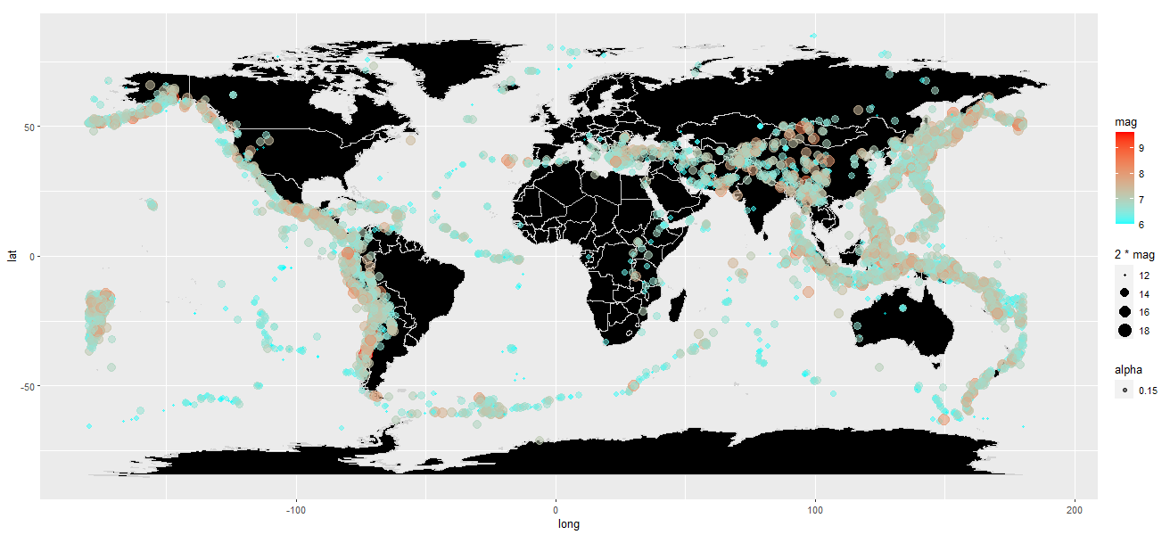
Earthquakes
worldmap2 + geom_point(data=earthquake, aes(longitude, latitude, color=mag,size=2*mag,alpha=0.15)) + scale_color_gradient(low="cyan", high = "red")

Slide 32
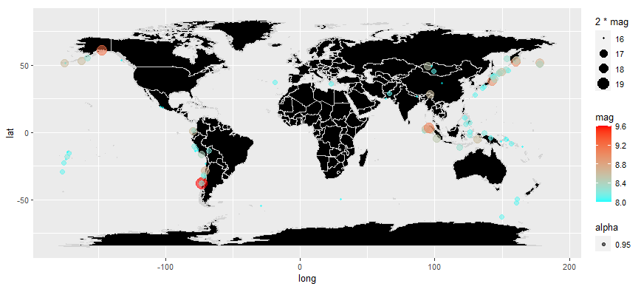
Strong Earthquakes
worldmap2 + geom_point(data=earthquake%>%filter(mag>=8), aes(longitude, latitude, color=mag,size=2*mag,alpha=0.95)) + scale_color_gradient(low="cyan", high = "red")

Slide 33
+ facet_wrap(~Year)
> earthquake$Date %>% head()
[1] "2014-03-17 UTC" "2014-03-16 UTC"
[3] "2014-03-15 UTC" "2014-03-15 UTC"
[5] "2014-03-13 UTC" "2014-03-11 UTC"
> format(earthquake$Date, "%Y") %>% head()
[1] "2014" "2014" "2014" "2014" "2014"
[6] "2014“
> earthquake$Year <- format(earthquake$Date, "%Y")
> colnames(earthquake)

Slide 34
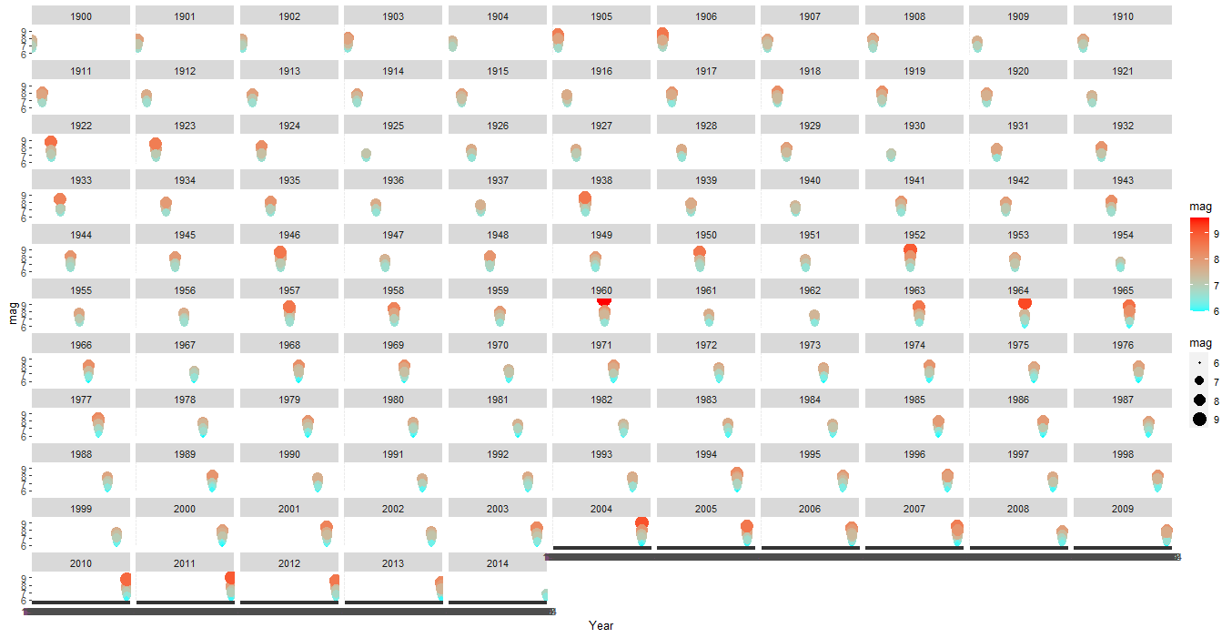
Filter
> ggplot() + geom_point(data=earthquake, aes(Year, mag, color=mag, size=mag)) + scale_color_gradient(high = "red", low = "cyan")+ facet_wrap(~Year)

Slide 35
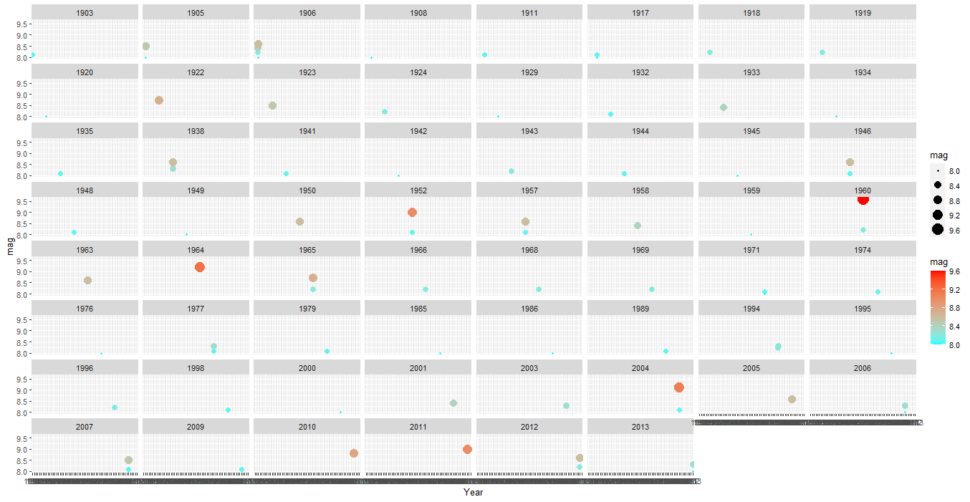
Filter
> ggplot() + geom_point(data=earthquake%>%filter(mag>=8), aes(Year, mag, color=mag, size=mag)) + scale_color_gradient(high = "red", low = "cyan")+ facet_wrap(~Year)

Slide 36
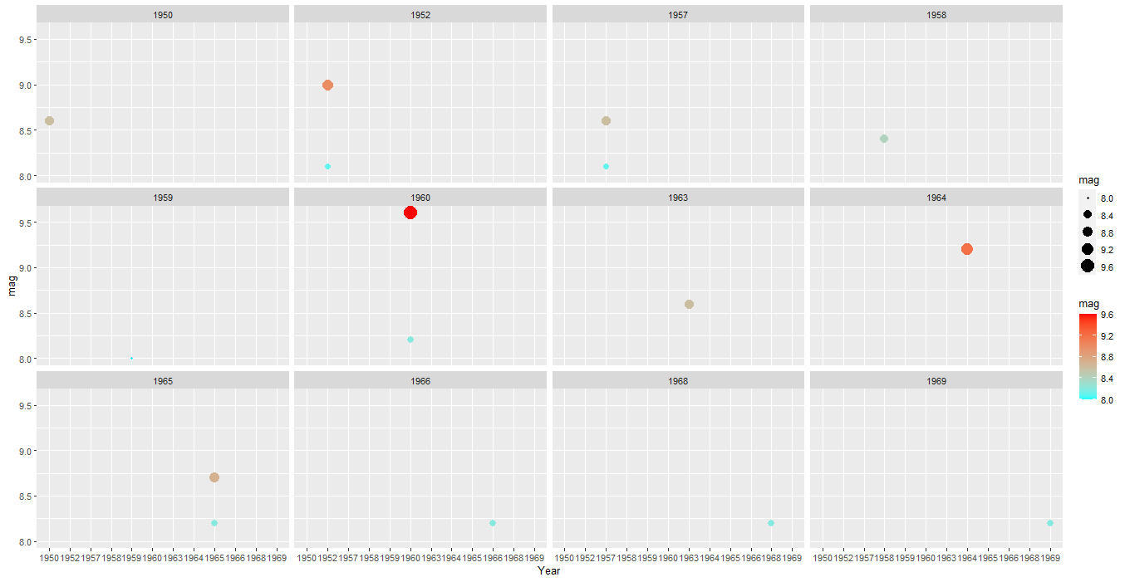
Filter
> ggplot() + geom_point(data=earthquake%>%filter(mag>=8, Year>=1950, Year<=1970), aes(Year, mag, color=mag, size=mag)) + scale_color_gradient(high = "red", low = "cyan")+ facet_wrap(~Year)

Slide 37
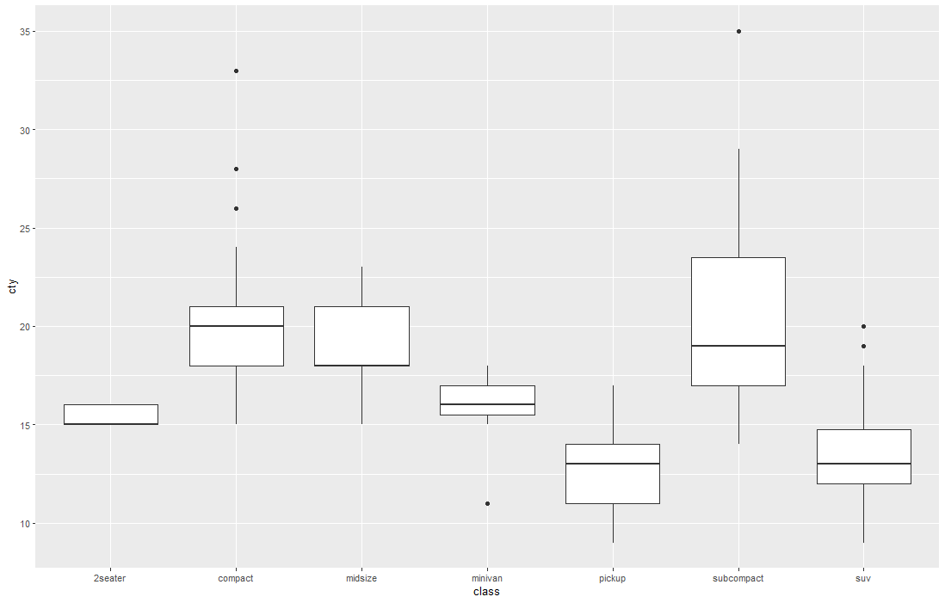
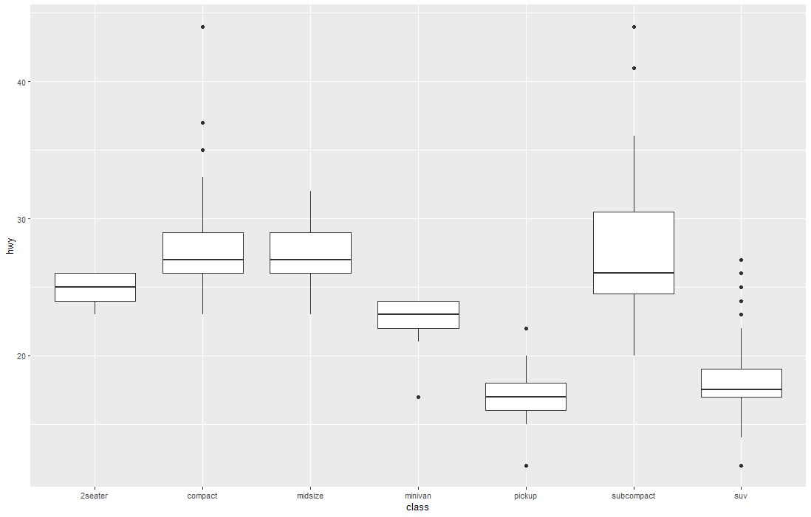
Boxplot
ggplot(mpg, aes(x=class, y=hwy))+geom_boxplot()

Slide 38
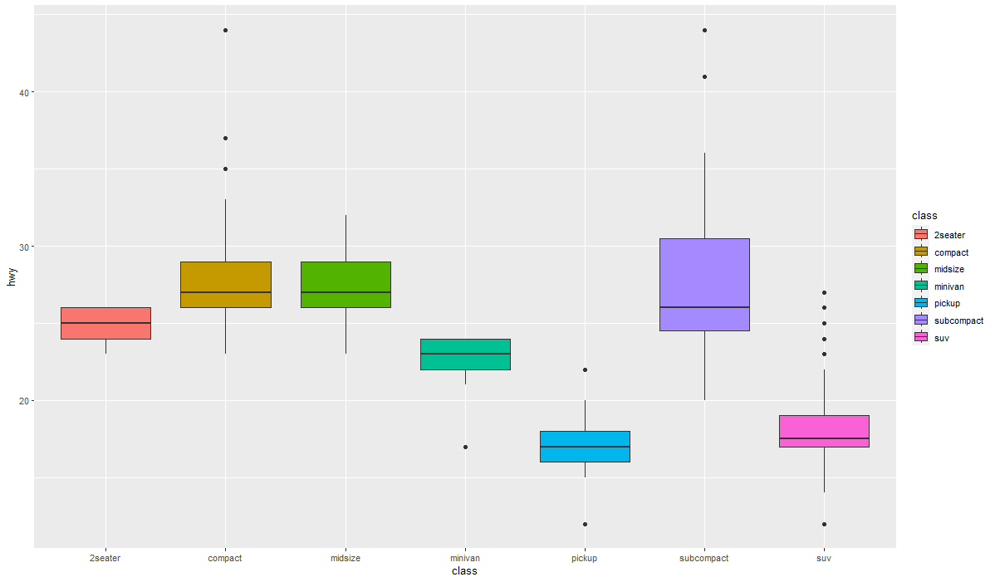
Boxplot
ggplot(mpg, aes(x=class, y=hwy, fill=class))+geom_boxplot()

Slide 39
Life Expectancy
CSV File
D:\Drexel\Teaching\INFO250\week4\life expectancy.csv
read.csv(file, header = TRUE, sep = ",", quote = "\"", dec = ".", fill = TRUE, comment.char = "", ...)
read.csv(“D:\Drexel\Teaching\INFO250\week4\life expectancy.csv”, header = TRUE)
life <- read.csv("D:\\Drexel\\Teaching\\INFO250\\week4\\life expectancy.csv", header = TRUE)
life0 <- life %>%
select(ParentLocation, SpatialDimValueCode,Location, Period, Dim1, Value)
> life0$continent <- life$ParentLocation
> life0$code <- life$SpatialDimValueCode
> life0$country <- life$Location
> life0$year <- life$Period
> life0$gender <- life$Dim1
> life0$expectancy <- life$Value

Slide 40
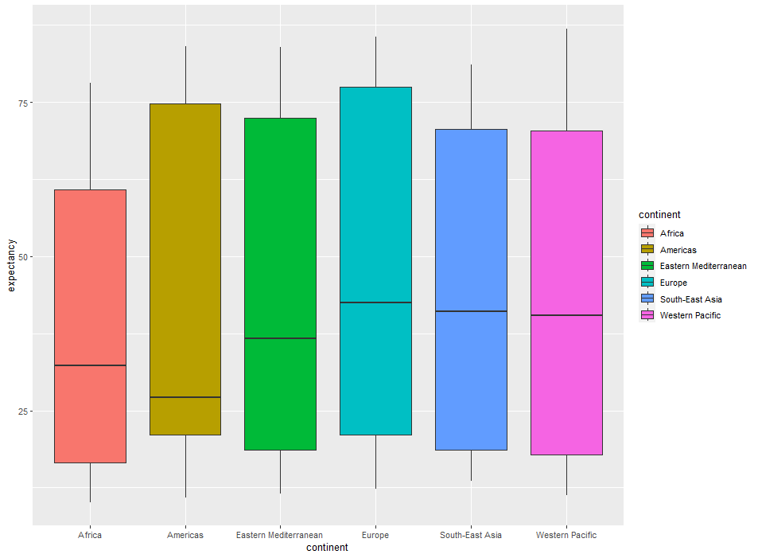
> ggplot(life0, aes(x=continent, y=expectancy, fill=continent))+geom_boxplot()

Slide 41
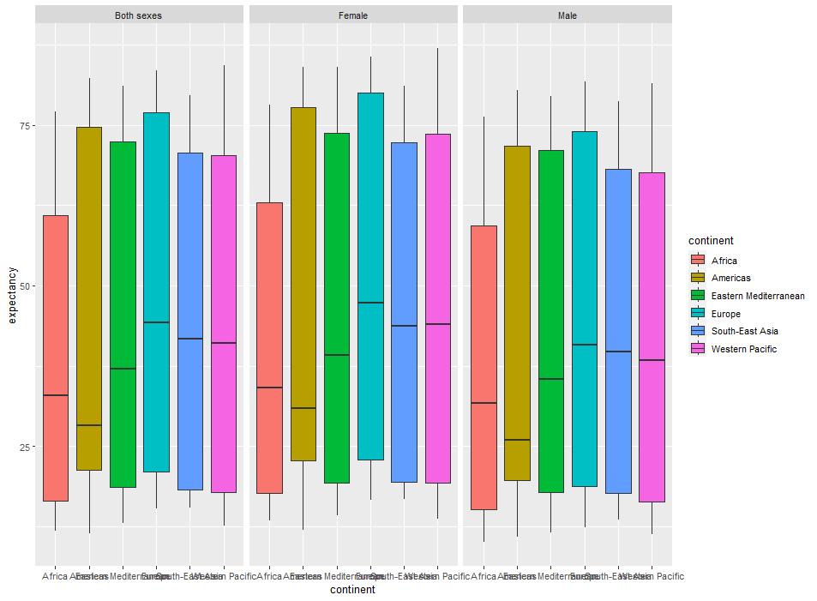

Slide 42
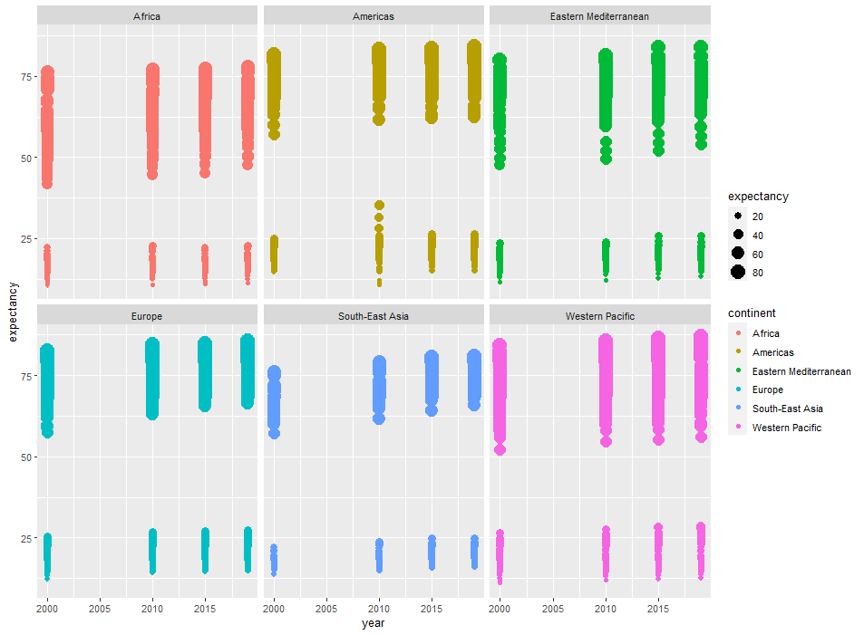
> ggplot(life0, aes(year, expectancy, color=continent, size=expectancy))+ geom_point()+facet_wrap(~continent)

Slide 43
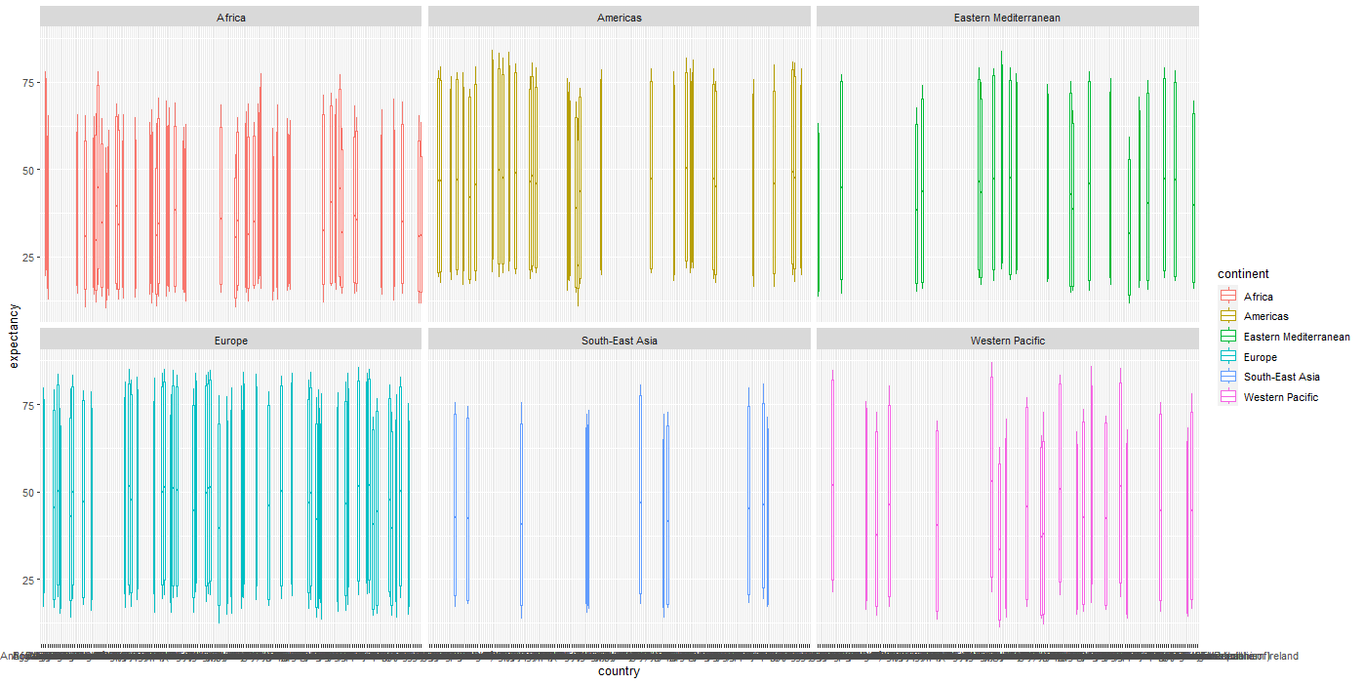
> ggplot(life0, aes(country, expectancy, color=continent))+geom_boxplot()+facet_wrap(~continent)

Slide 44
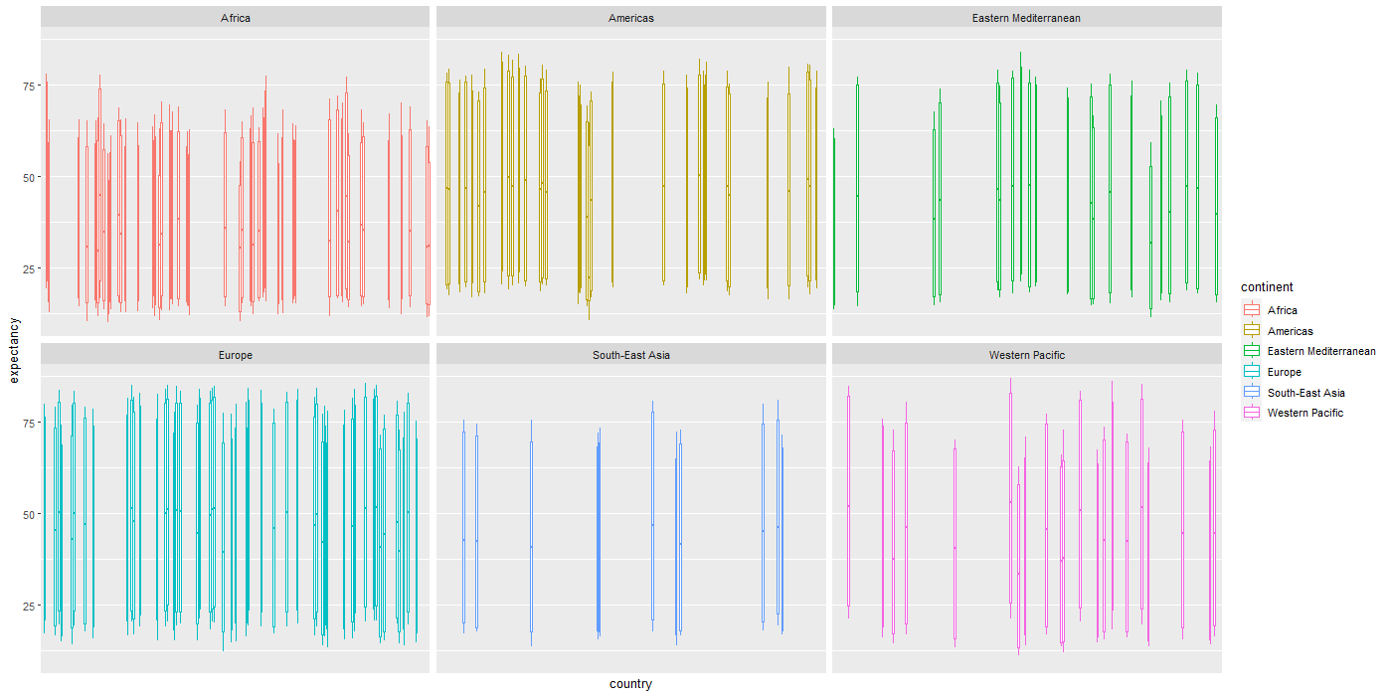
> ggplot(life0, aes(country, expectancy, color=continent))+geom_boxplot()+facet_wrap(~continent) + scale_x_discrete(labels = NULL, breaks = NULL)

Slide 45
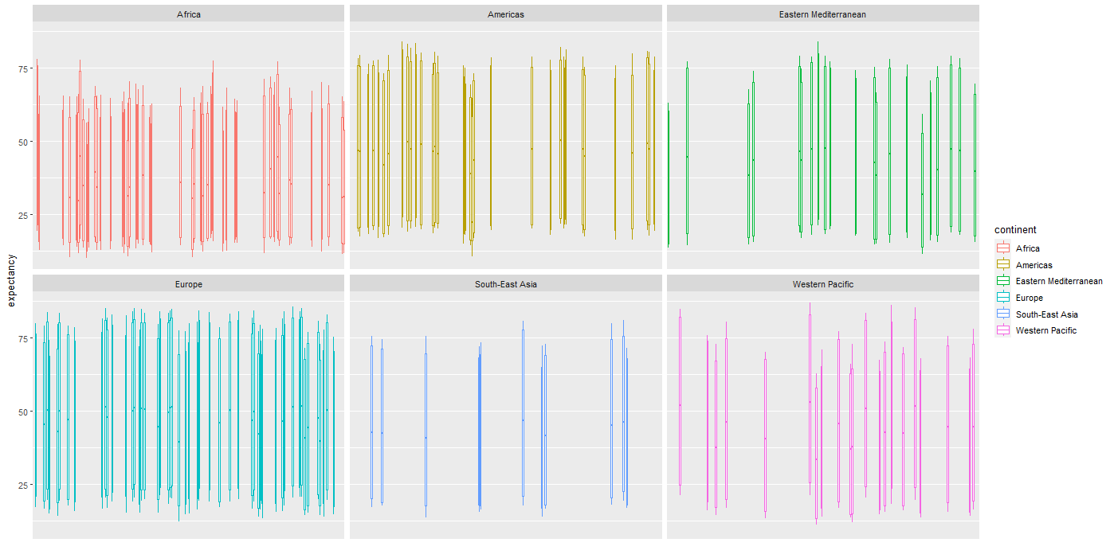
> ggplot(life0, aes(country, expectancy, color=continent))+geom_boxplot()+facet_wrap(~continent) + scale_x_discrete(labels = NULL, breaks = NULL) + labs(x = "")

Slide 46
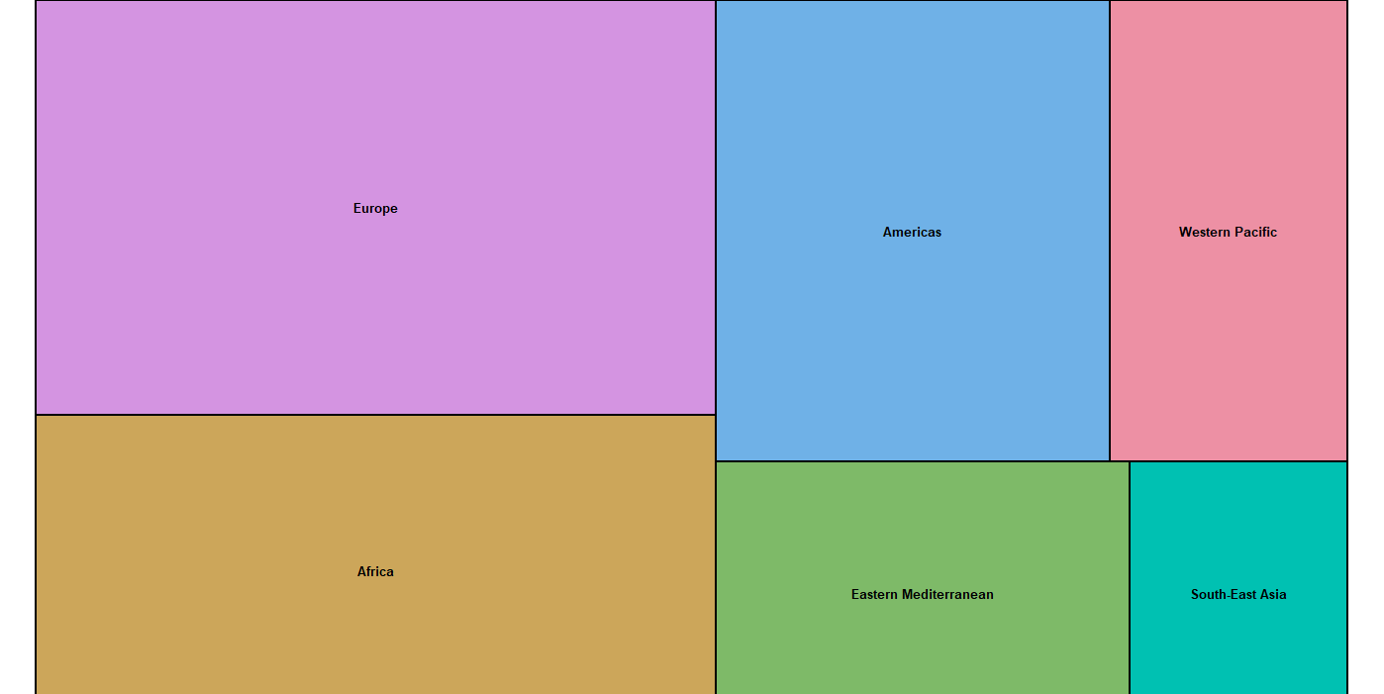
Treemap
> install.packages("treemap")
> library(treemap)
> treemap(life0, index = c("continent"), vSize="expectancy")

Slide 47
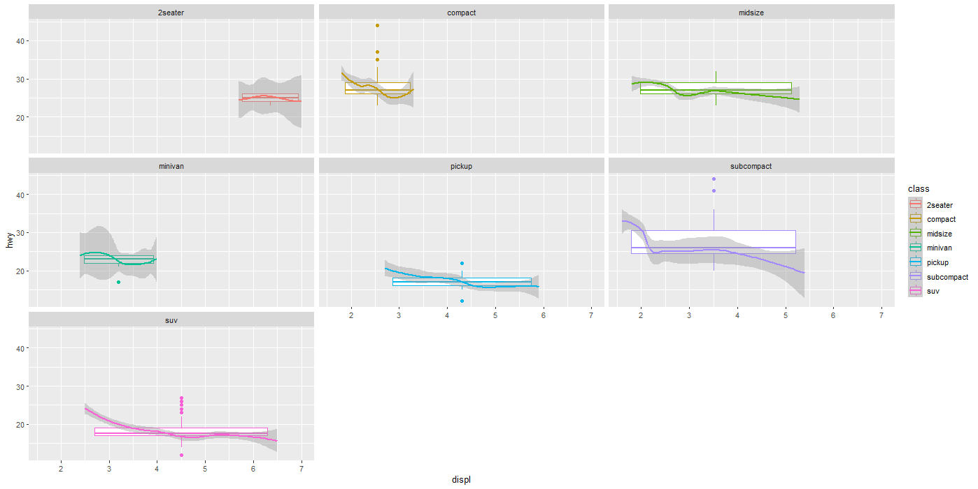
> ggplot(mpg, aes(displ, hwy, color=class, size = cty))+geom_boxplot()+geom_smooth() + facet_wrap(~class)

Slide 48
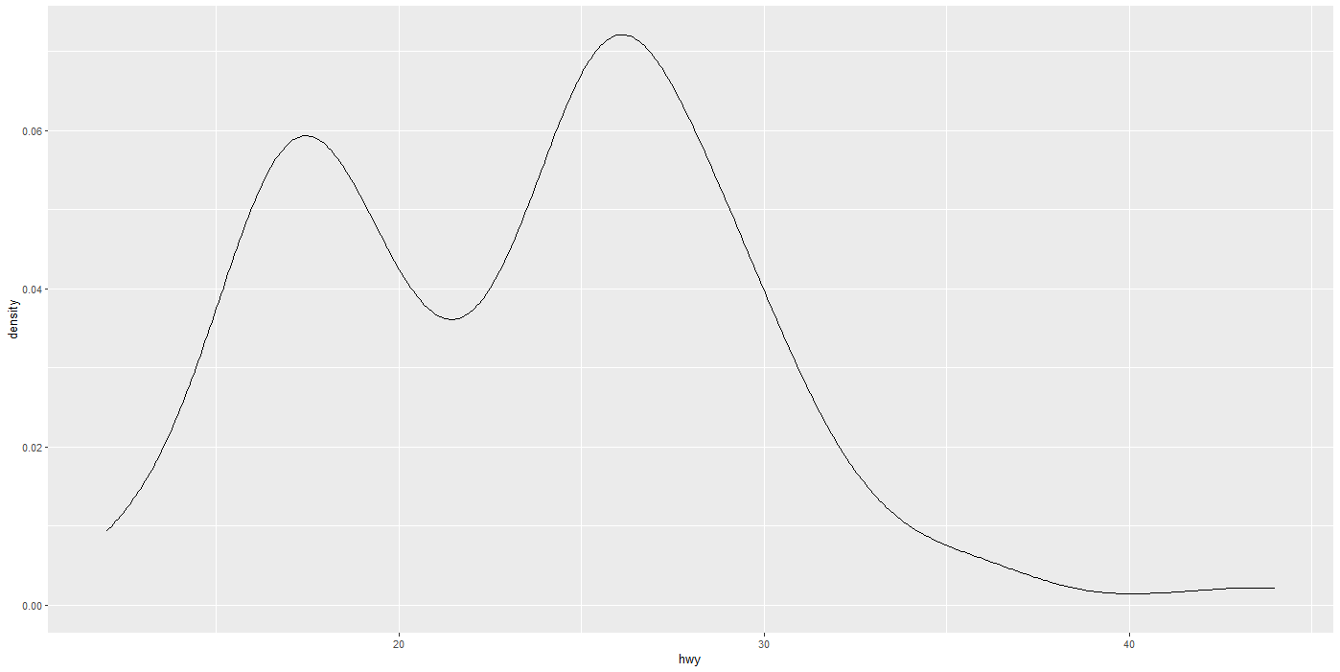
ggplot(mpg, aes(x=hwy)) + geom_density()

Slide 49
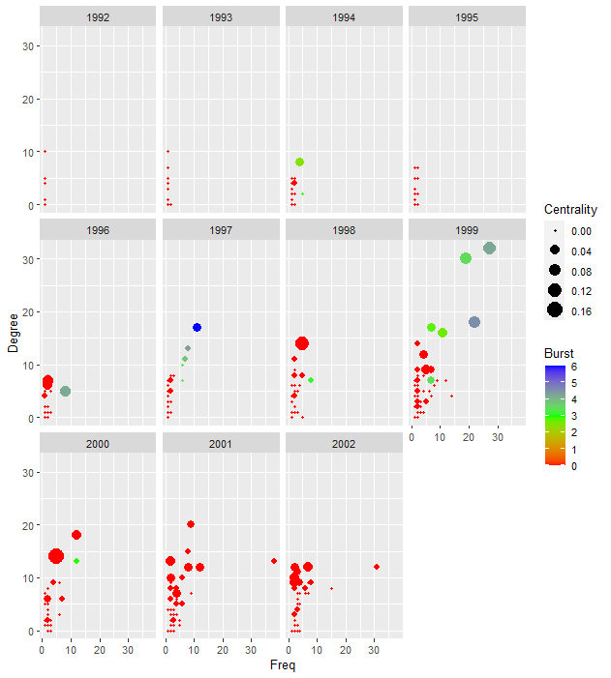
ggplot(terrorism, aes(Freq, Degree, color=Burst, size=Centrality))+ geom_point()+facet_wrap(~Year) + scale_color_gradientn(colours = rainbow(3))

